Slide 1
Borders and Gateways: Measuring and Analyzing National AS Chokepoints
Kirtus Leyba
Arizona State University
July 5th, 2019
ACM COMPASS 2019 (Accra, Ghana)

Slide 2
National Internet Control
Source: New York Times (2011)
Source: CNET (2019)

Slide 3
Research Questions
Evolution of Internet Borders.
Redundancies or Reuse?
Internet Topology and Internet Freedom?

Slide 4
Internet Topology

Slide 5
Layers of Abstraction
Application Layer
Transport Layer
Internet Layer
Link Layer
We’re working here!
ABSTRACTION

Slide 6
Border Gateway Protocol (BGP)
BGP is the routing protocol of the most abstract layer of Internet hierarchy.
BGP routes traffic between Autonomous Systems (ASes)
ISPs
University Networks
Networks for Large Corporations
Government Networks

Slide 7
Our Approach

Slide 8
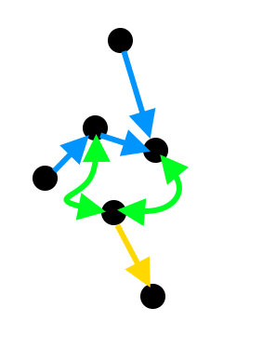
CAIDA AS Relationship Dataset
Publicly available inferred AS relationships every month
Team Cymru WHOIS service to determine nation to node mapping

Slide 9
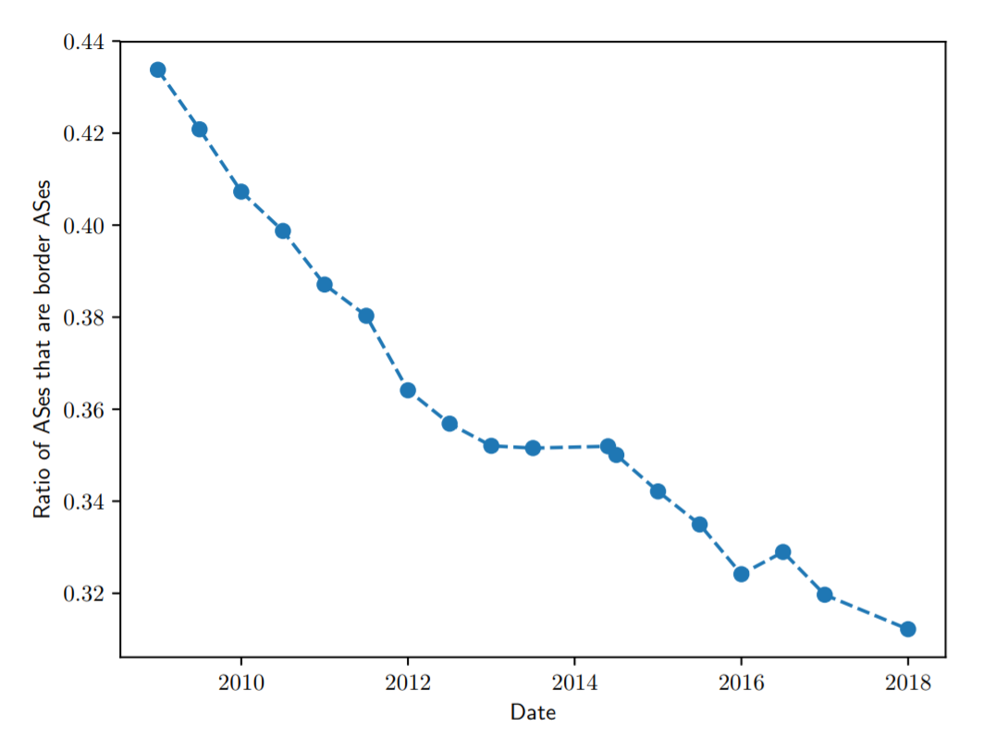
Are Internet Borders becoming stronger?

Slide 10
Chokepoint Potential

Slide 11
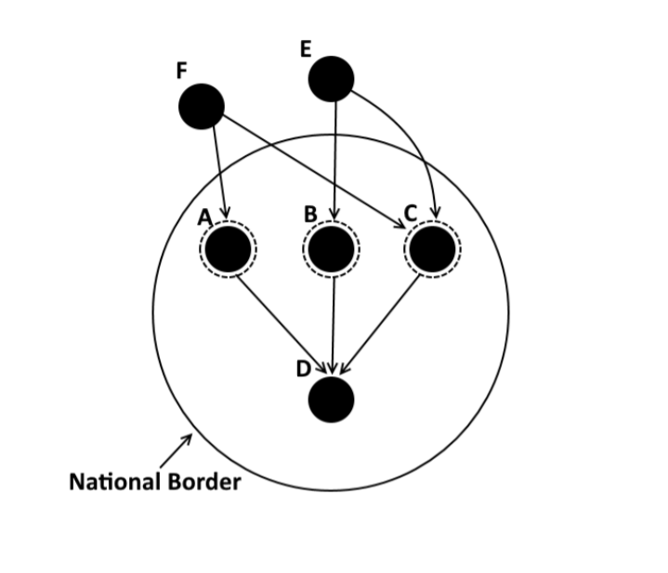
Chokepoint Potential
A measure of the ratio of international Internet paths intercepted by a border AS.
Border AS: An AS connected to at least one other AS from a different nation than its own.
$$cp\left(a\right)=\frac{\left|\left\{p:p∈P and a∈p\right\}\right|}{\left|P\right|}$$
Where $P$ is the set of paths crossing a nation’s border.
0.25
0.5
0.25

Slide 12
National Chokepoint Potential
Aggregate form of chokepoint potential for an entire nation.
Defined as a function of the number of border ASes required to intercept a percentage $f$ of border crossing paths.
$$CP\left(c,f\right)=\frac{1}{j}$$
Where $j$ is the smallest $j$ such that $\sum_{i=1}^{j}{cp\left(a_{i}\right)>f}$

Slide 13
Results

Slide 14
Measuring AS Chokepoints in different nations (2018)
China can intercept about 90% of its international routes with few ASes.
There is a large diversity of chokepoint potentials for various nations.

Slide 15
The Evolution of Internet Borders

Slide 16
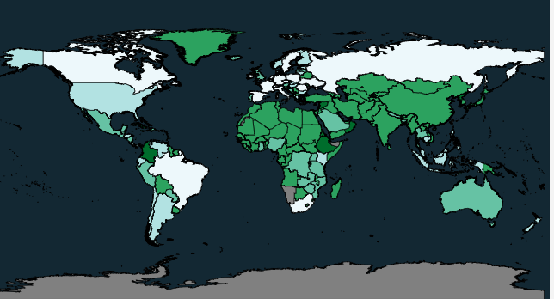
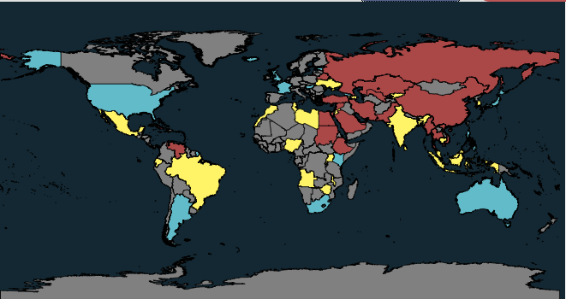
An Application: Internet and Press Freedom
National Chokepoint Potential
Internet Freedom

Slide 17
Data Processing

Slide 18
Data Techniques
Started with AS relationship dataset from CAIDA
Used a modified BFS algorithm and Gao-Rexford routing model to identify paths between AS pairs.
Generated routing trees for each destination AS.
Calculated chokepoint potential for each border AS using the large routing tree dataset

Slide 19
Tools and Data
All these tools are bundled as BGP-Simulation Analysis and Storage (BGP-SAS)
The data for 10 years of BGP routing trees is over 200GB compressed (2+ TB uncompressed)
Both available publicly at https://kirtusleyba.github.io/routingtrees.html

Slide 20
Co-Authors
Benjamin Edwards
Cyentia Institute
BJEdwards@gmail.com
Cynthia Freeman
University of New Mexico
cynthiaw2004@gmail.com
Jedidiah R. Crandall
University of New Mexico
crandall@cs.unm.edu
Stephanie Forrest
Arizona State University
steph@asu.edu

Slide 21
Questions?

